Slide 1
I/O port programming

Slide 2
PIC18F458

Slide 3
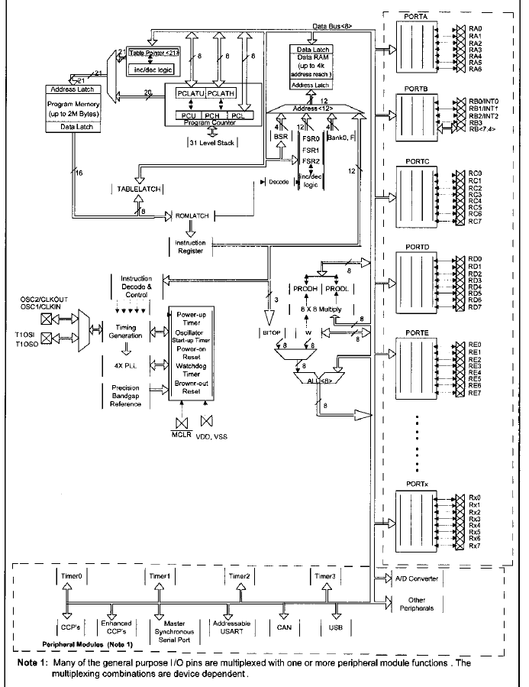
Block diagram of PIC18

Slide 4
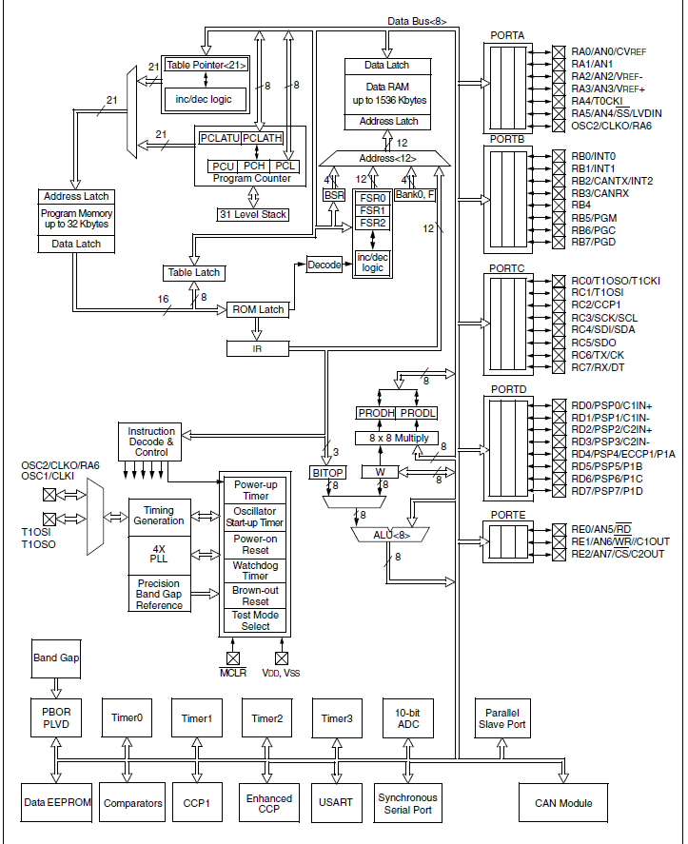

Slide 5
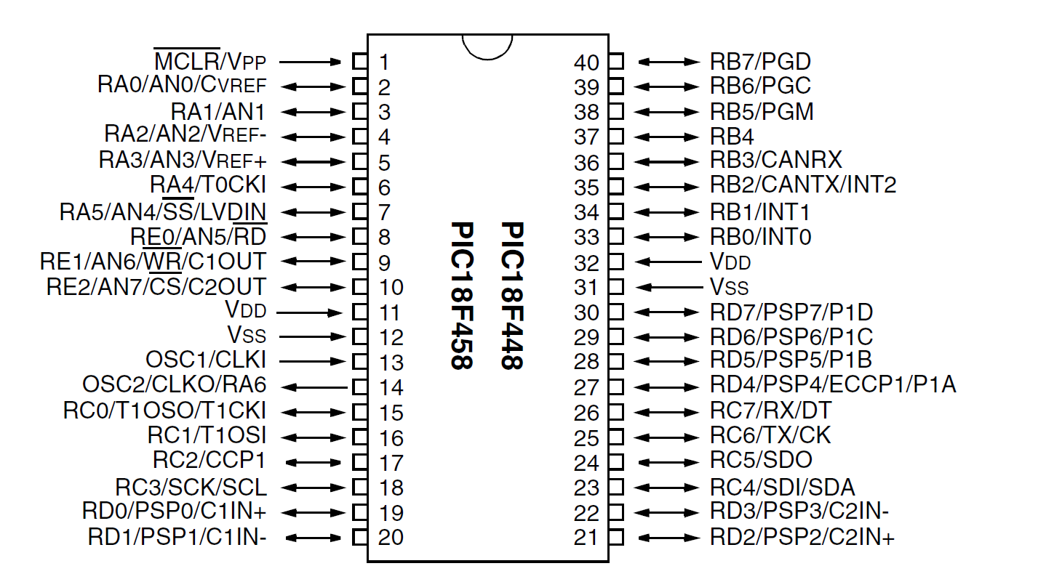

Slide 6
PORTS
PORTA, PORTB, PORTC, PORTD, PORTE
I/O, ADC, Timer, Interrupt, Serial communication pins

Slide 7
PORTA – 7pins
PORTB,PORTC,PORTD – 8 pins
PORTE – 3 pins

Slide 8
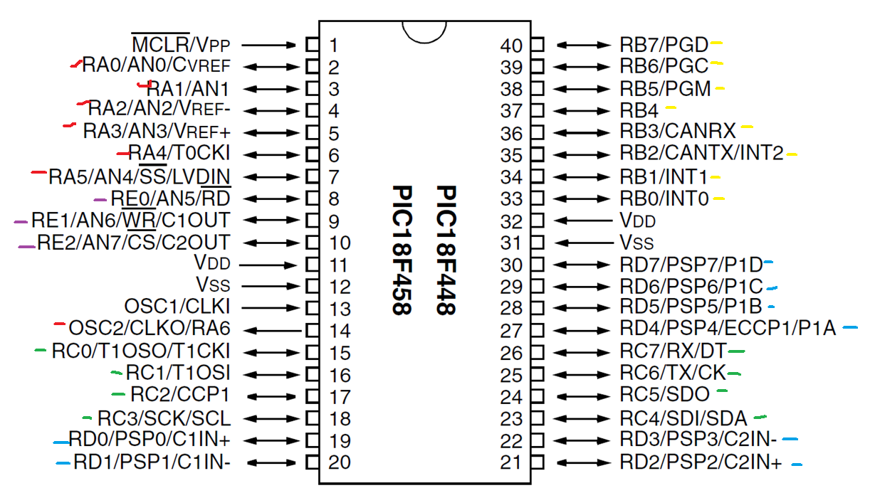

Slide 9
Each port is associated with 3 special function registers (SFR)
PORTx
TRISx (TRIState)
LATx (LATch)

Slide 10
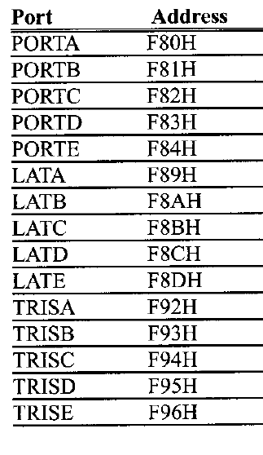

Slide 11
TRIS register
Make a pin in a port to input or output mode

Slide 12
TRIS register
Make a pin in a port to input or output mode
0- output
1- input

Slide 13
TRIS register
Make a pin in a port to input or output mode
0- output ➔ data is copied to corresponding bit in PORTx register
1- input ➔ data is read from corresponding bit in PORTx register

Slide 14
Latch Registers
LATx registers are the port latch registers.

Slide 15
Latch Registers
LATx registers are the port latch registers.
When a data is written to PORTx register, it is first stored in LATx register and then copied to PORTx.

Slide 16
Latch Registers
LATx registers are the port latch registers.
When a data is written to PORTx register, it is first stored in LATx register and then copied to PORTx.
If TRISx register is not 0, then data is not copied to PORTx but remains in LATx.

Slide 17
Latch Registers
When a data is read from PORTx register, it is first stored in LATx register and then copied to WREG.
If TRISx register is not 0xFF, then data is not copied from PORTx but from LATx.

Slide 18
I/O ports and bit addressability

Slide 19
I/O ports and bit addressability
BCF f,b → clear bit b
BSF f,b → set bit b
BTG f,b → toggle (complement) bit b

Slide 20
I/O ports and bit addressability
BCF f,b → clear bit b
BSF f,b → set bit b
BTG f,b → toggle (complement) bit b
BTFSC f,b → bit test skip next instruction if clear
BTFSS f,b → bit test skip next instruction if set

Slide 21
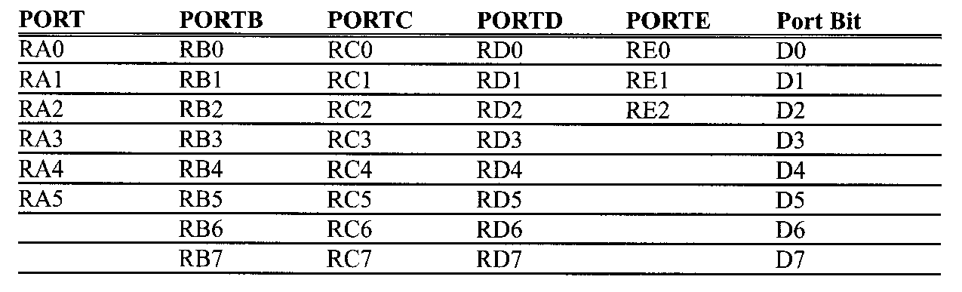

Slide 22
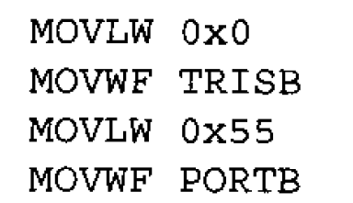
TRISB 01000001
PORTB=55H
LATB 01010101
PORTB 00010100 =14H

Slide 23
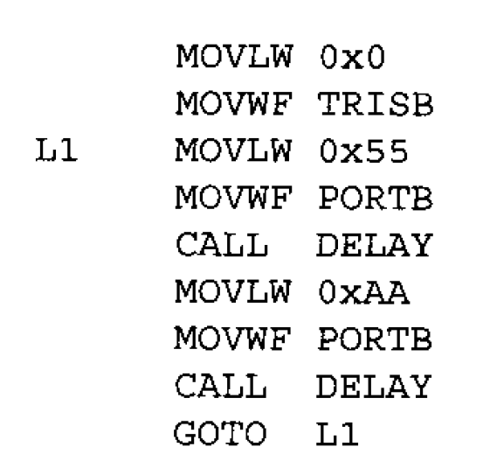
PORTB 55H 01010101
AAH 10101010

Slide 24
Read data from port B, add 5 to it and output sum at port C

Slide 25
Read data from port B, add 5 to it and output sum at port C
MOVLW 0x00
MOVWF TRISC
MOVLW 0XFF
MOVWF TRISB
MOVF PORTB
ADDLW 0X5
MOVWF PORTC

Slide 26
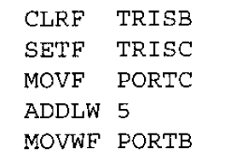
Read data from port C, add 5 to it and output sum at port B

Slide 27
Read followed by a write operation

Slide 28
Read followed by a write operation
Read data from Port C to WREG, store the data to Port B .

Slide 29
Read followed by a write operation
Read data from Port C to WREG, store the data to Port B.
CLRF TRISB
SETF TRISC
MOVF PORTC
MOVWF PORTB

Slide 30
Instruction flow or Pipelining
Instruction cycle consists of 4 cycles.
Fetch the instruction
Decode the instruction
Read the data
Execute the instruction

Slide 31
Instruction 1 | Fetch | Decode | Read | Execute
Instruction 2 |  | Fetch | Decode | Read | Execute
Instruction 3 |  |  | Fetch | Decode | Read | Execute
Instruction 4 |  |  |  | Fetch | Decode | Read | Execute

Slide 32
MOVF PORTC | Fetch | Decode | Read | Execute
MOVWF PORTB |  | Fetch | Decode | Read | Execute

Slide 33
MOVF PORTC | Fetch | Decode | Read | Execute
MOVWF PORTB |  | Fetch | Decode | Read | Execute

Slide 34
Data dependency
Read after write

Slide 35
Read after read (No problem)
Read after write
Write after read
Write after write

Slide 36
Read followed by a write operation
Read data from Port C to WREG, store the data to Port B.
CLRF TRISB
SETF TRISC
MOVF PORTC
NOP
MOVWF PORTB

Slide 37
MOVF PORTC | Fetch | Decode | Read | Execute
NOP |  | Fetch | Decode | Read | Execute
MOVWF PORTB |  |  | Fetch | Decode | Read | Execute

Slide 38
CLRF TRISB
SETF TRISC
MOVFF PORTC, PORTB

Slide 39
Write a program to toggle the bits of ports B,C, and D every ¼ of a second. Assume the crystal frequency 4MHz.

Slide 40
Crystal frequency : frequency of the crystal oscillator connected between OSC1 and OSC2 pins
The instruction execution time depends on this frequency

Slide 41
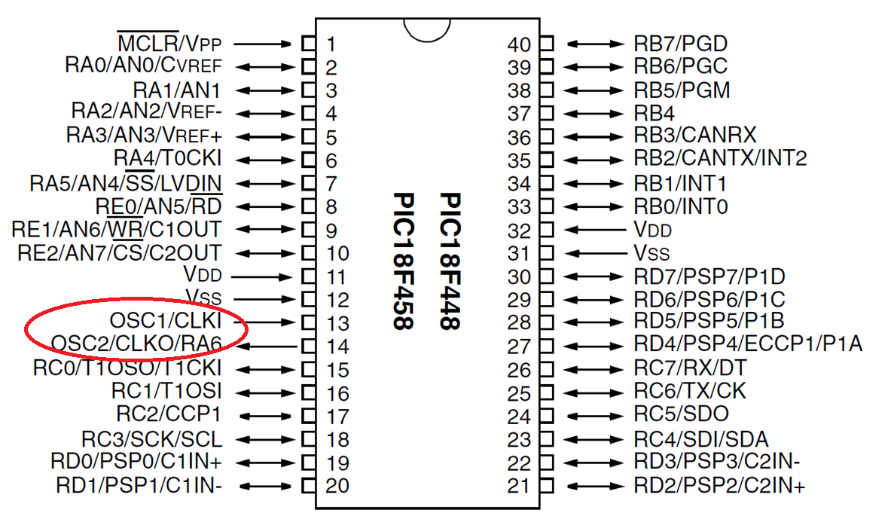

Slide 42
Instruction cycle time for the PIC
The time taken for the CPU to execute an instruction is called instruction cycle or machine cycle.
All the instructions of PIC18 are either 2-byte or 4-byte
Most instructions take no more than 1 or 2 instruction cycles to execute.
In PIC18, one instruction cycle consists of 4 oscillator periods.
Therefore to calculate the instruction cycle for the PIC18, we take ¼ of the crystal frequency

Slide 43
Data transfer instructions require 1 machine cycle except MOVFF (2 cycles)
Branch instructions require 2 machine cycles

Slide 44
Delay calculations
Time delay = 0.25 s
Crystal frequency = 4 MHz
Instruction cycle frequency = 1MHz
Time of one cycle = 1 * 10⁻⁶ s
No operation instruction to be repeated for N cycles
N= Time delay / time of one cycle = 0.25* 10⁶ = 250000

Slide 45
QDELAY
R1 EQU 0x05
R2 EQU 0x06
MOVLW n1
MOVWF R1
D1 MOVLW n2
MOVWF R2
D2 NOP
NOP
DECF R2
BNZ D2
DECF R1
BNZ D1
RETURN
For(r1=n1;r1>0;r1--)
{
for(r2=n2;r2>0;r2--)
{
nop
nop
}
}

Slide 46
QDELAY
R1 EQU 0x05
R2 EQU 0x06
MOVLW n1
MOVWF R1
D1 MOVLW n2
MOVWF R2
D2 NOP
NOP
DECF R2
BNZ D2
DECF R1
BNZ D1
RETURN

Slide 47
QDELAY
R1 EQU 0x05
R2 EQU 0x06
MOVLW n1
MOVWF R1
D1 MOVLW n2
MOVWF R2
D2 NOP
NOP
DECF R2
BNZ D2
DECF R1
BNZ D1
RETURN
N= n1*n2*5

Slide 48
QDELAY
R1 EQU 0x05
R2 EQU 0x06
MOVLW n1
MOVWF R1
D1 MOVLW n2
MOVWF R2
D2 NOP
NOP
DECF R2
BNZ D2
DECF R1
BNZ D1
RETURN
N= n1*n2*5
N=250000
n1*n2=50000

Slide 49
QDELAY
R1 EQU 0x05
R2 EQU 0x06
MOVLW n1
MOVWF R1
D1 MOVLW n2
MOVWF R2
D2 NOP
NOP
DECF R2
BNZ D2
DECF R1
BNZ D1
RETURN
N= n1*n2*5
N=250000
n1*n2=50000
n1=200
n2=250

Slide 50
QDELAY
R1 EQU 0x05
R2 EQU 0x06
MOVLW D’200’
MOVWF R1
D1 MOVLW D’250’
MOVWF R2
D2 NOP
NOP
DECF R2
BNZ D2
DECF R1
BNZ D1
RETURN
N= n1*n2*5
N=250000
n1*n2=50000
n1=200
n2=250

Slide 51
list P=PIC18F458
#include P18F458.INC
R1 EQU 0x07
R2 EQU 0x08
ORG 0
CLRF TRISB
CLRF TRISC
CLRF TRISD
MOVLW 0x55
MOVWF PORTB
MOVWF PORTC
MOVWF PORTD
LP COMF PORTB
COMF PORTC
COMF PORTD
CALL QDELAY
GOTO LP
QDELAY
MOVLW D’200’
MOVWF R1
D1 MOVLW D’250’
MOVWF R2
D2 NOP
NOP
DECF R2
BNZ D2
DECF R1
BNZ D1
RETURN
END

Slide 52
Complement instruction
COMF reg , d
d= 0 or 1
Content of reg is complemented and stored in WREG if d is 0
Otherwise it is stored in reg.

Slide 53
Complement instruction
COMF reg , d
d= 0 or 1
Content of reg is complemented and stored in WREG if d is 0
Otherwise it is stored in reg.
Instead of 0/1 we can use W/F.

Slide 54
Branch instruction
BRA - equivalent to GOTO

Slide 55
list P=PIC18F458
#include P18F458.INC
R1 EQU 0x07
R2 EQU 0x08
ORG 0
CLRF TRISB
CLRF TRISC
CLRF TRISD
MOVLW 0x55
MOVWF PORTB
MOVWF PORTC
MOVWF PORTD
LP COMF PORTB, F
COMF PORTC, F
COMF PORTD, F
CALL QDELAY
BRA LP
QDELAY
R1 EQU 0x05
R2 EQU 0x06
MOVLW D’200’
MOVWF R1
D1 MOVLW D’250’
MOVWF R2
D2 NOP
NOP
DECF R2
BNZ D2
DECF R1
BNZ D1
RETURN
END

Slide 56
An LED is connected to each pin of Port D. Write a program to turn on each LED from pin D0 to pin D7. Call a delay module turning on next LED

Slide 57
CLRF TRISD
BSF PORTD,0
CALL DELAY
BSF PORTD,1
CALL DELAY
BSF PORTD,2
CALL DELAY
BSF PORTD,3
CALL DELAY
BSF PORTD,4
CALL DELAY
BSF PORTD,5
CALL DELAY
BSF PORTD,6
CALL DELAY
BSF PORTD,7
CALL DELAY

